Slide 1

Pokemon Analysis
Project 3 – Data Bootcamp

Slide 2

Introduction
Pokémon Stats

Slide 3
Choosing our API
Pokémon Stats
We were really limited with the amount of free API’s available as the majority we came across were chargeable.
The Pokémon API seemed the most fun, it was interesting and the data it held could provide some really good analysis points for us to tie in graphs and mapping

Slide 4
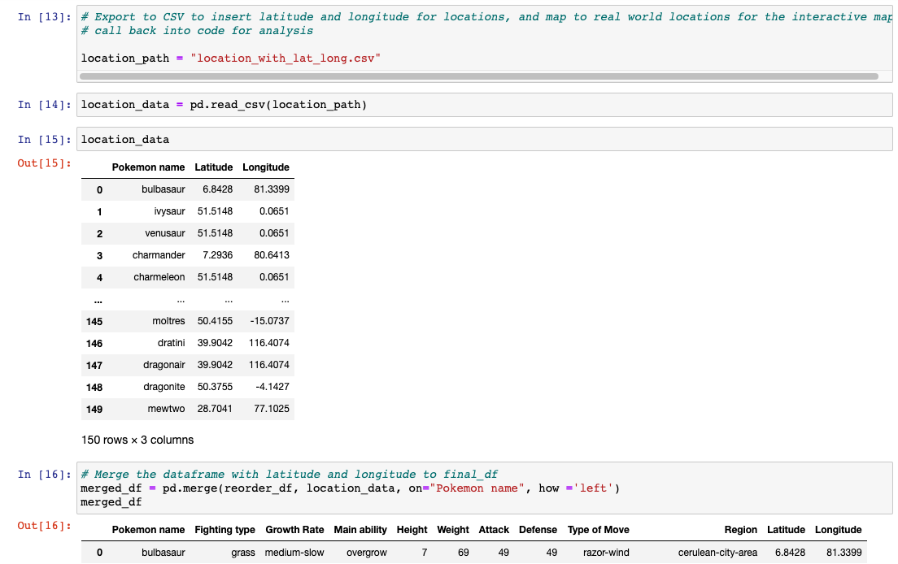
Extracting the Data
We came across several issues when starting to call from the API to turn into a DataFrame.
As we wanted to use the location of the Pokémon as a data visualization some manual intervention was needed during this.
The Pokémon regions were based on fictional places, so we had to extract the data into a CSV and add real world co-ordinates in to be able to map this, then import this back in to merge with the DataFrame

Slide 5
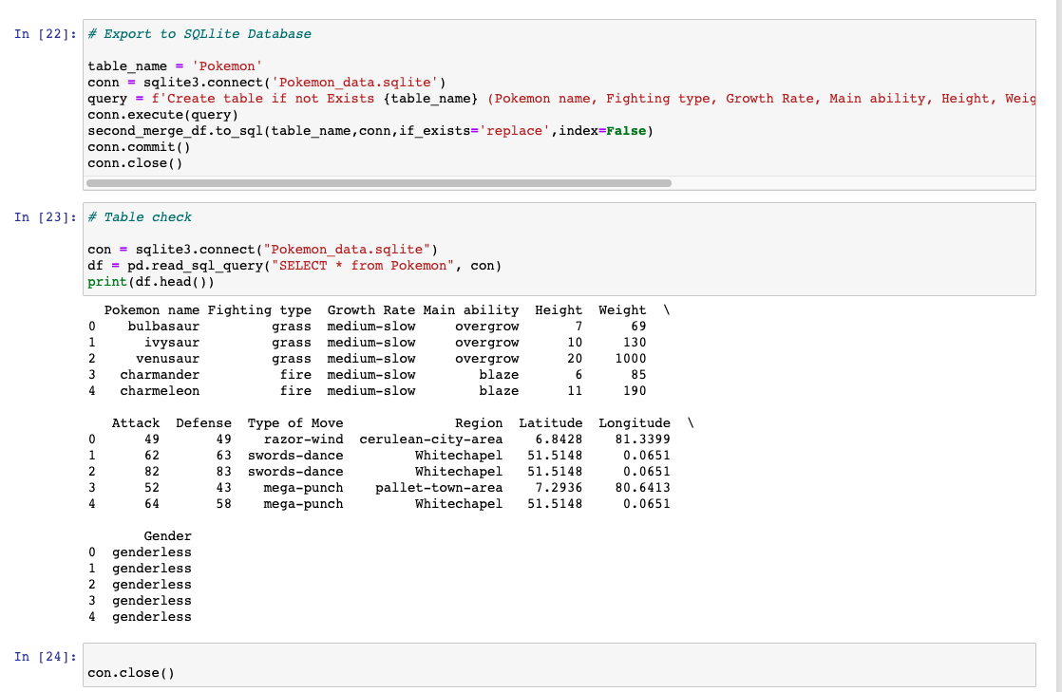
Loading to a Database
Once our DataFrame was cleaned and ready for analysis with the fields we were planning to use we exported it to SQLite and tested the database in Jupyter Notebook

Slide 6
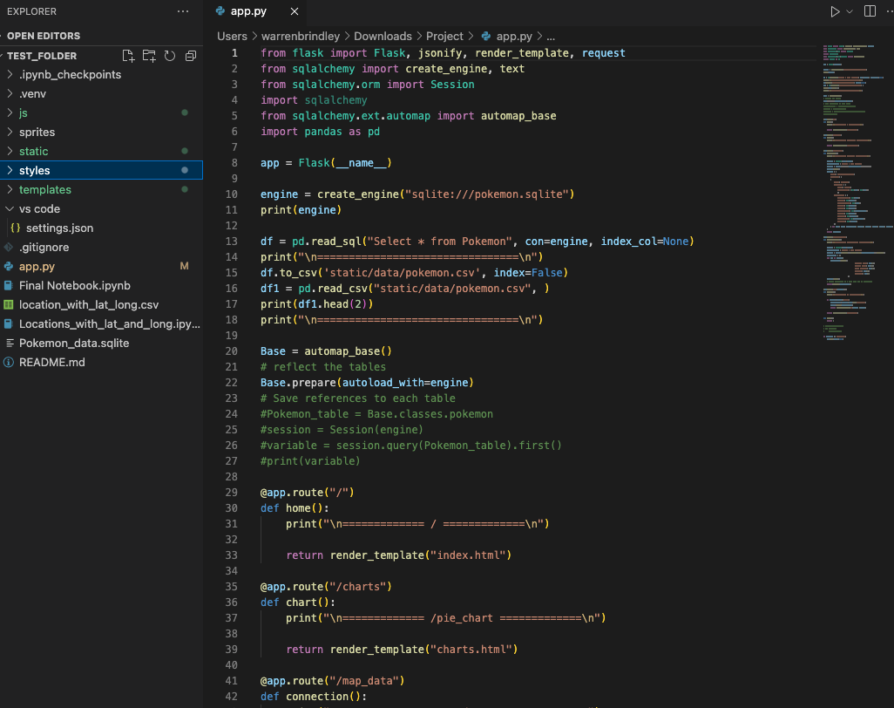
Using Flask
Once our database was completed, we started the process of using Flask to continue with our analysis.
We came across many, many issues with this.
This took the most amount of time to sort as all our machines were throwing up different errors.
However, being the amazing Mac user group, we got through it

Slide 7

Creating the Visuals
We decided on 3 Visualisations
Growth Rate
Location
Attack and Defense

Slide 8
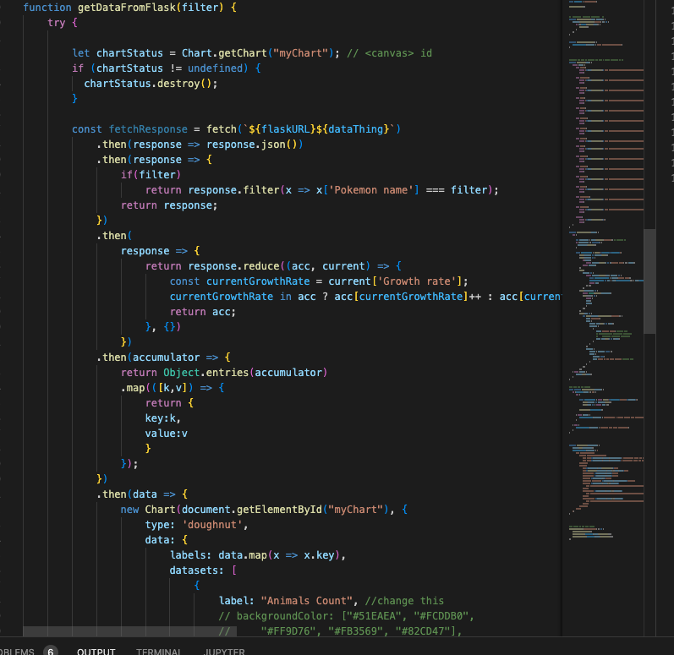
The Growth Chart
We decided to use Charts.JS and have this visual interact with the main page of our Project
We decided on a doughnut chart as it seemed to display this data better than a bar

Slide 9
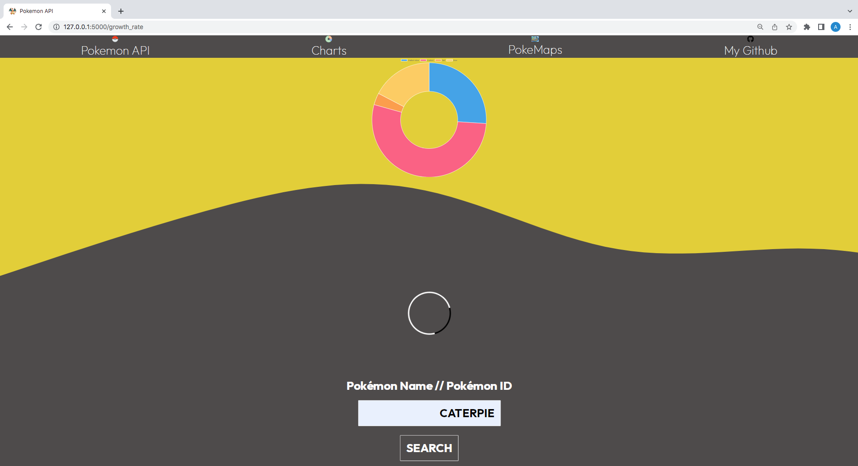
The result
This is how the growth chart was displayed on the main index html
It is fully interactive with the text box to enter your Pokémon and has labels
Data trends we noticed were the majority of Pokémon had medium growth, some of the larger Pokémon had slow growth and the Pokémon that had a few evolutions were quicker

Slide 10
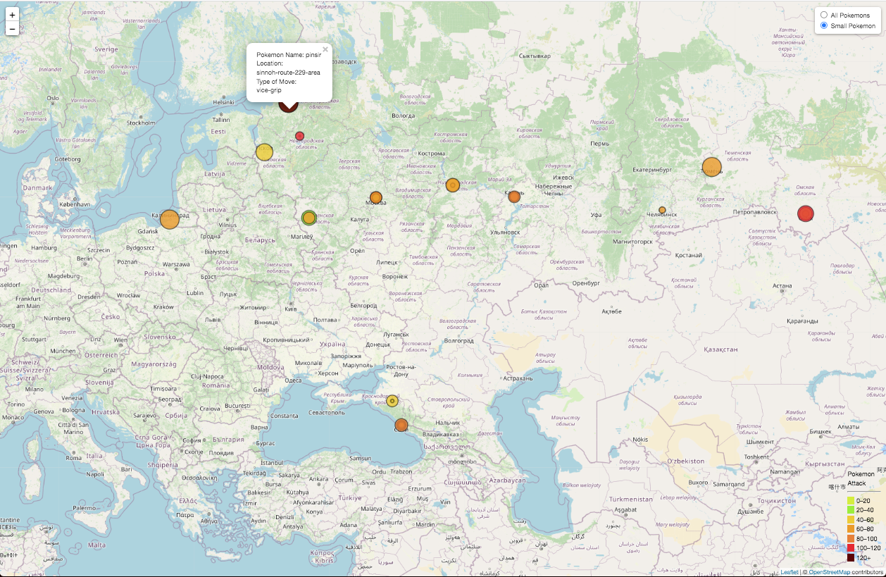
Mapping the Pokémon
We wanted to show a fictional World map for the Pokémon and the location you could catch them
We displayed it on this map using the Attack Value as the size of the marker with an interactive dropdown to highlight the small Pokémon

Slide 11
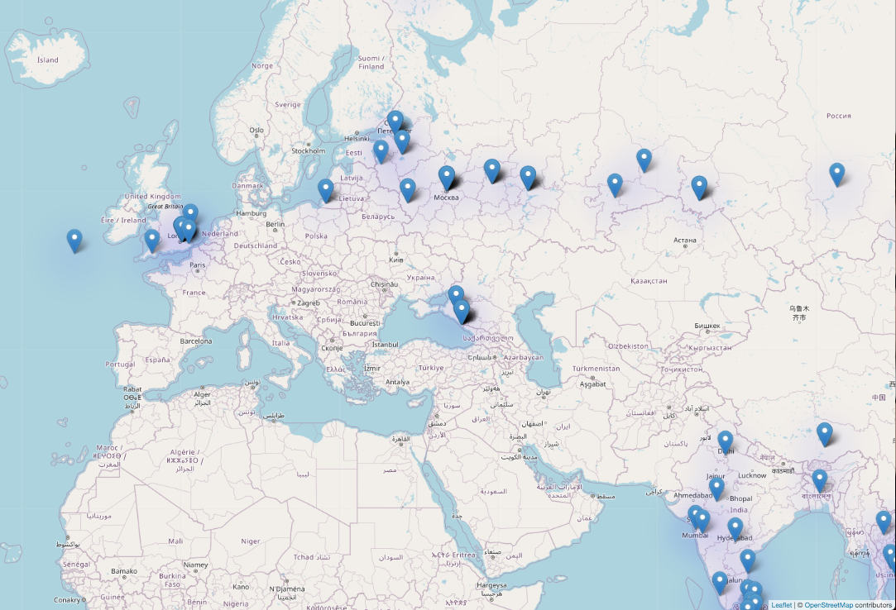
Mapping the Pokémon
We also used a heatmap to display the Pokémon by location

Slide 12
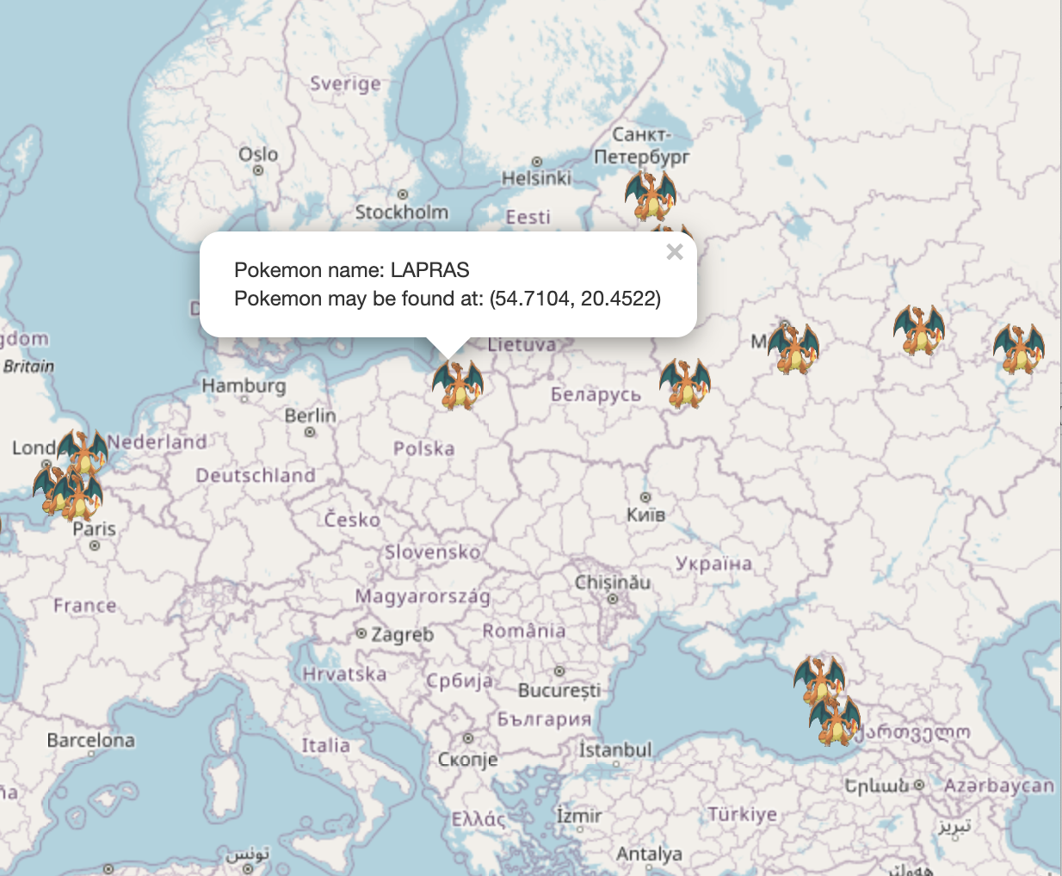
Mapping the Pokémon
We finally used a combination of HTML and CSS with Charizard markers to make a visually appealing interface for the user.

Slide 13
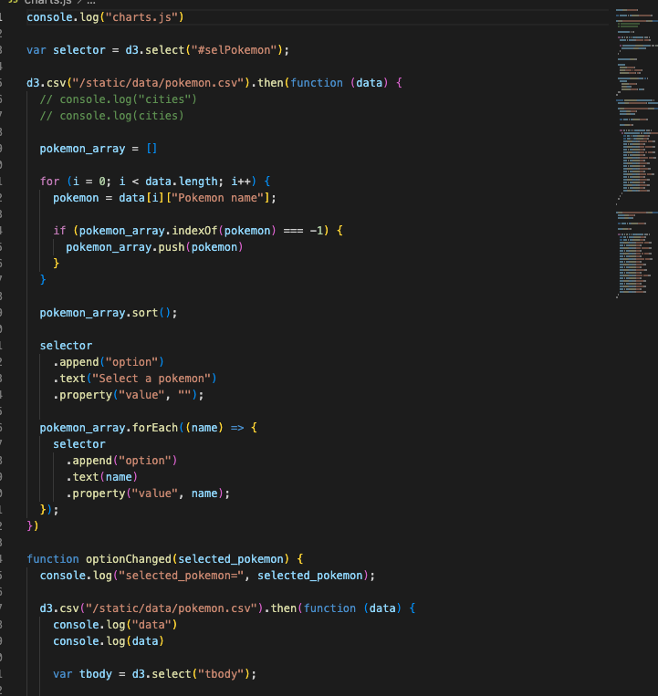
Attack VS Defence
To determine what visualisation I was going to use, I browsed through the d3 gallery to find what would be appropriate for my dataset.
We started by creating a database schema with tables for Pokémon, attacks, and defence.
Populated the database with data we retrieved from our Pokémon API for the Pokémon, attacks, and defence tables.

Slide 14
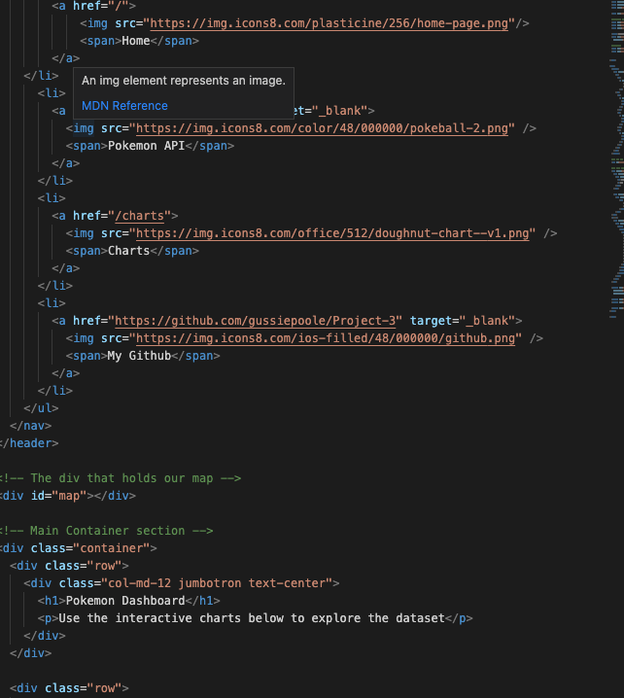
Wrote JavaScript code to retrieve data from the SQLite database and display it on the HTML page.
Use HTML and CSS to create a visually appealing interface for the user to view the data.

Slide 15
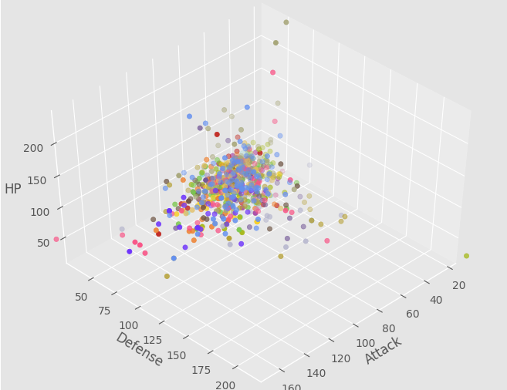
Scatter Chart
We also produced a scatter chart displaying the attack vs defense to see if there was any sort of pattern.

Slide 16
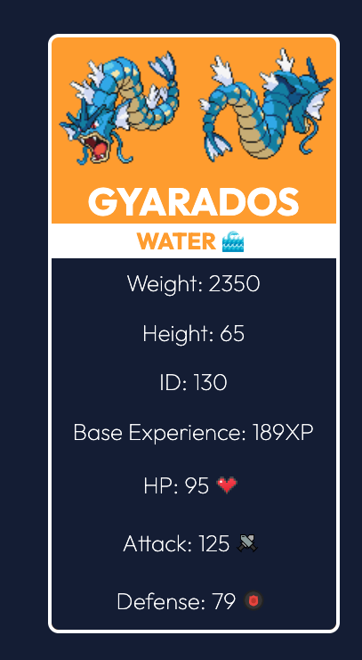
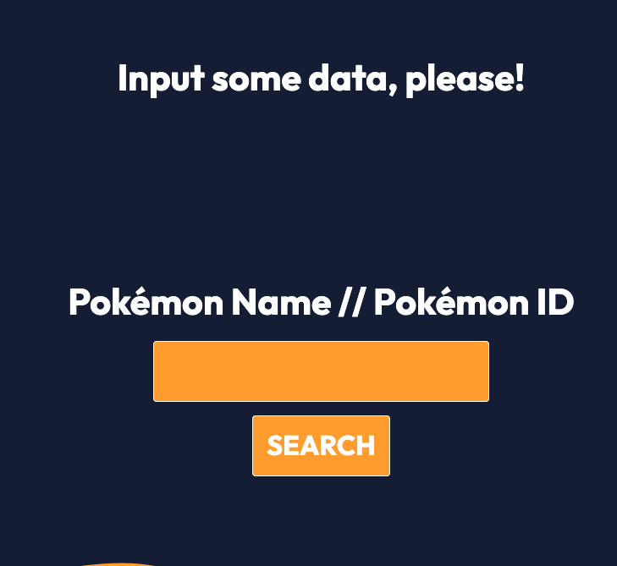
Designing the HTML Pages
We wanted an interactive design where the stats would pop up once typing the Pokemon in with a small Picture.

Slide 17
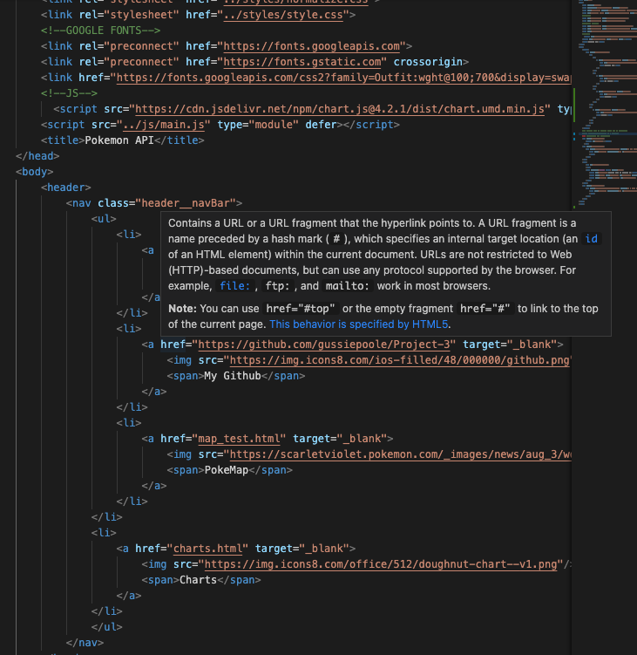
Coding the HTML
We called the Javascript files and HTML pages we created to tie this all in together
Added links in the top bar to link to the other HTML files we created

Slide 18
Any Questions?

